Slide 1
Astro 331 Lesson 2
Mission Design and
Requirements Definition
SMAD Ch 1, 2.3 & 4

Slide 2
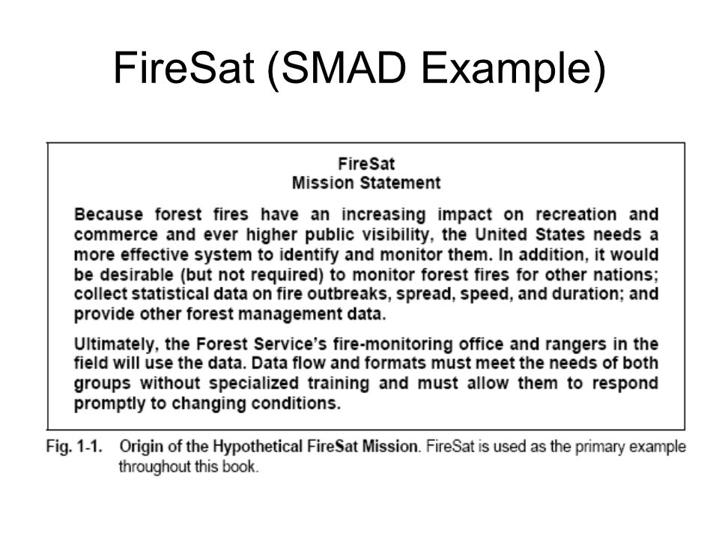

Slide 3
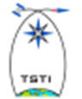
FireSAT Requirements & Constraints
Functional Rqmts | Operational Rqmts | Constraints
Performance 30 m resolution 500 m location accuracy Coverage Daily for USA Responsiveness - Send registered data within 30 min of detecting fire to up to 50 users Secondary Mission 4 temperature levels for pest management | Duration - At leat 5 yrs Availability 98% excluding weather 3-day maximum outage Timeliness Survivability - Natural environment only Data Distribution - Up to 500 fire-monitoring office & 2000 rangers worldwide with a max of 100 simultaneous users Data Content, Form, & Format Location and extent of fire on any of 12 map bases Average temperature for each 30 square meter grid Data Storage | Cost - <$20 million/yr plus R&D costs Schedule IOC in 5 yrs FOC in 6 yrs Regulations - NASA mission (federal regs and procurement constraints apply) Political Limits - Responsive to public demand for actions Economic Return Environment Interfaces - Communication relay and interoperable through NOAA ground stations Development Constraints Launch on Shuttle or expendable No unique operations people at data distribution nodes Spacecraft Disposal
Adapted from Designing Space Mission and Systems,
Teaching Science and Technology, Inc.

Slide 4
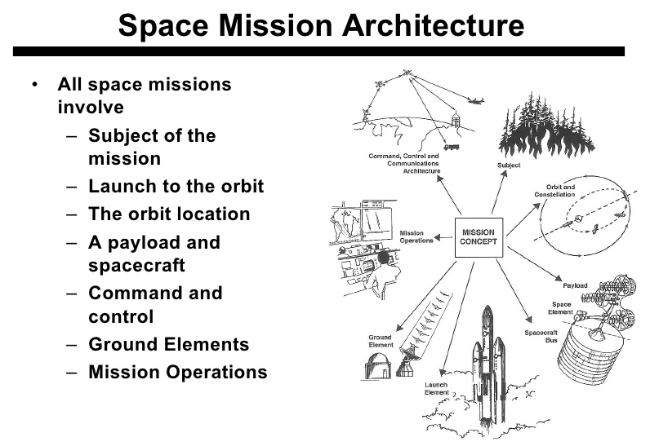
Fig 1-3 Space Mission Architecture

